Slide 1
PREDICTIVE Analytics ON PRUDENTIAL LIFE INSURANCE APPLICANT DATA
Advanced Data Sciences and Architecture
Team 8
Shruti Mehta | Sushma | Fiona |Sreevatsan

Slide 2
About the project?
AIM:
Based on the applicant data, predict the risk levels(range 1-8) to make decisions on the insurance approval.
APPROACH:
We are pre-processing the data to build predictive models.
Building predictive models using linear regression, decision tree regression and SVM regression techniques.
Evaluating and comparing the performance of each model using test data.

Slide 3
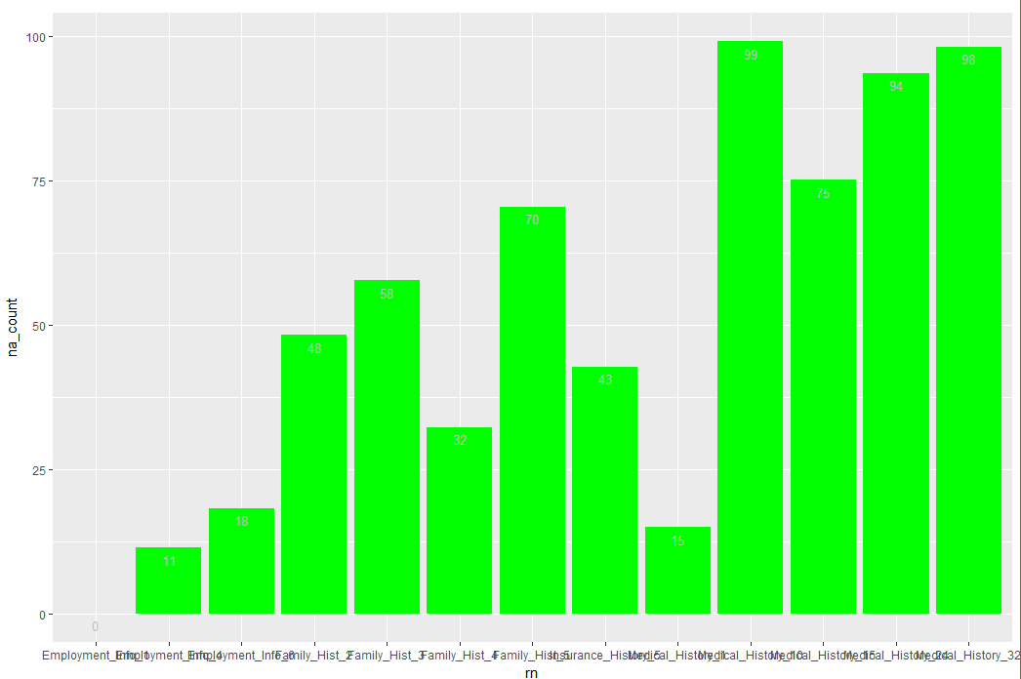
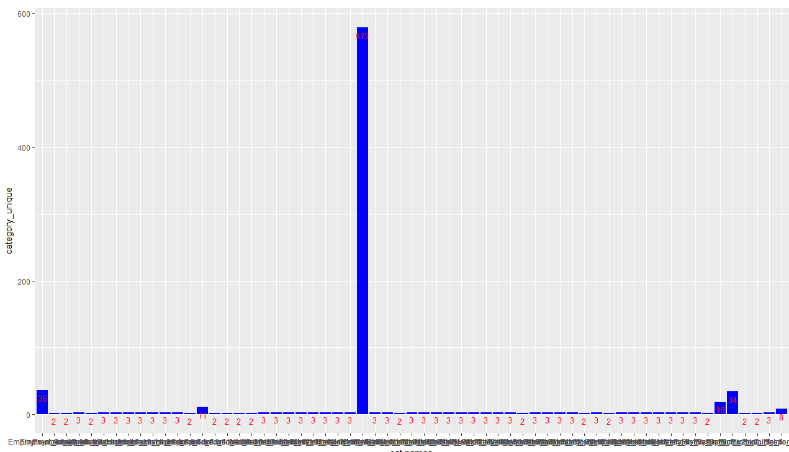
Pre-Processing of Data
Given:
The Prudential life insurance dataset has 127 independent variables and 1 dependent variables with over 58000 records. These 128 features are either continuous, discrete or categorical in nature.
Data Cleaning:
Eliminated the dimensions containing more than 60% of missing values.
Removed the dimensions having more than 6 categories.

Slide 4
Pre-Processing of Data
Data Imputation:
Imputed the missing values with the mean for continuous or discrete variables.
0 to C Transformation:
Categorical variables are converted to numerical(binary) by 0 to C transformation technique using ‘acm.disjonctif’ function in R.
Dimension Reduction:
We used linear regression to reduce the dimensions. The dimensions with Pr value more than 0.05 were taken off as they were less significant.

Slide 5
Linear regression
In statistics, linear regression is an approach for modeling the relationship between a scalar dependent variable y and one or more explanatory variables (or independent variables) denoted X.

Slide 6
Linear regression

Slide 7
Linear regression

Slide 8
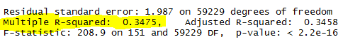

Linear regression

Slide 9
SVM regression
Support Vector Machines are very specific class of algorithms, characterized by usage of kernels, absence of local minima, sparseness of the solution and capacity control obtained by acting on the margin, or on number of support vectors, etc.

Slide 10
Tuning and Building SVM model
Tuning with radial kernel resulted in better performance, so the model was built with kernel as ‘radial’, cost as 10 and gamma as 0.5.

Slide 11
SVM regression

Slide 12


DECISION TREE REGRESSION
Decision tree builds regression or classification models in the form of a tree structure. It brakes down a dataset into smaller and smaller subsets while at the same time an associated decision tree is incrementally developed. The final result is a tree with decision nodes and leaf nodes.

Slide 13
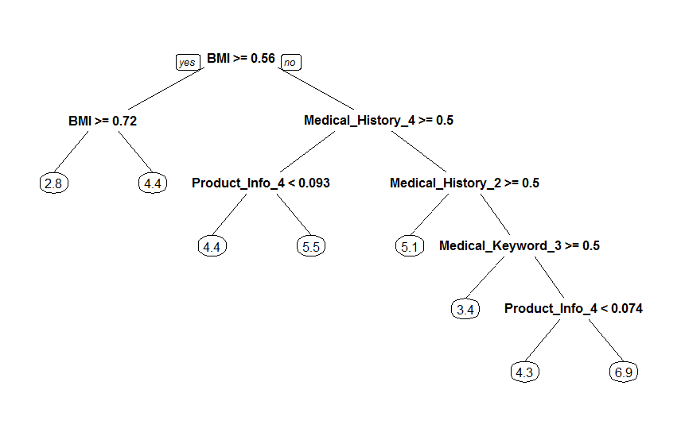
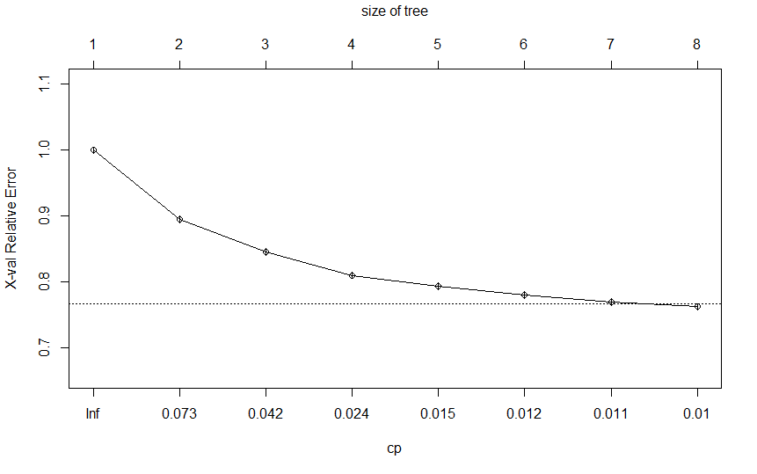
DECISION TREE REGRESSION

Slide 14
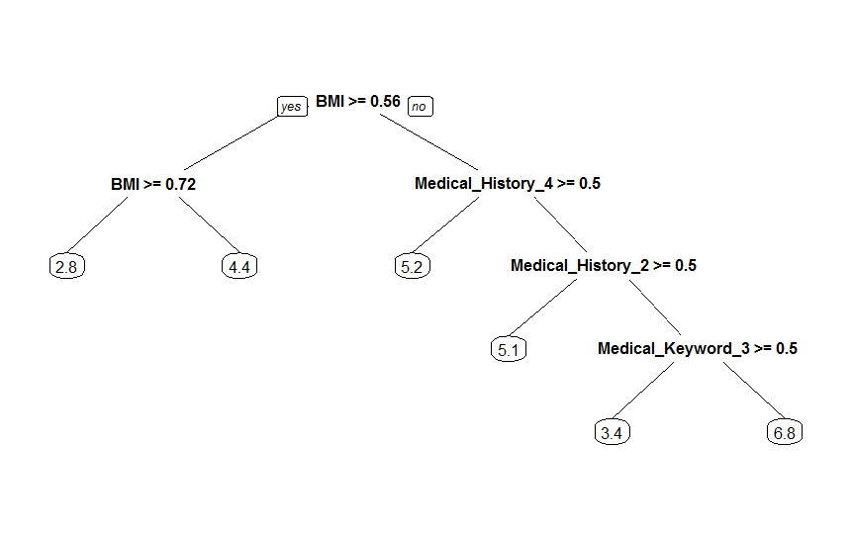
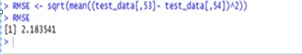
DECISION TREE REGRESSION

Slide 15
Thank You ☺

